Slide 1
CMPE272: ScaleIt.Up
Aditya Chauhan
Manikant Prasad
Megha nair
Vidhya Vijayakumar

Slide 2
CONTENTS
Project Overview
Requirements
Architecture Diagram
Technologies Used
Features
Future Projects

Slide 3
Project Overview
Our application provides an interface to employees in the organisation to subscribe and tweet into their twitter account for Social Promotion
Provides an interface for the Marketing team to upload the images and blurbs that the employees can use to tweet into their twitter account.
The App helps business promotion on twitter, with the marketing team the product can be marketed through twitter. This will be a secure place to keep the marketing strategies

Slide 4
REQUIREMENTS
Employees:
Login into the Application with their twitter account
Should be able to tweet and retweet the blurbs or images provided by the marketing team
Marketing Team:
Add, Update and Delete Blurbs or Images

Slide 5
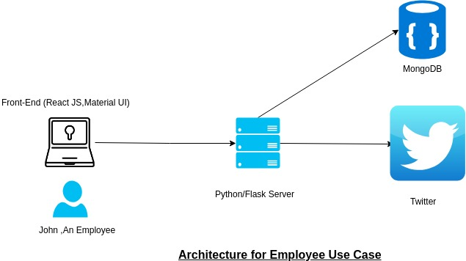
ARCHITECTURE DIAGRAM
Employee Architecture Diagram

Slide 6
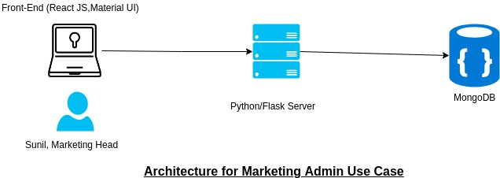
ARCHITECTURE DIAGRAM
Marketing Admin Architecture Diagram

Slide 7
TECHNOLOGY USED
Front End:REACT JS, Material UI
RESTful backend service framework: Python/Flask
API: Twython API
NoSQL Database: mongodB
Image Store : Google Firebase

Slide 8
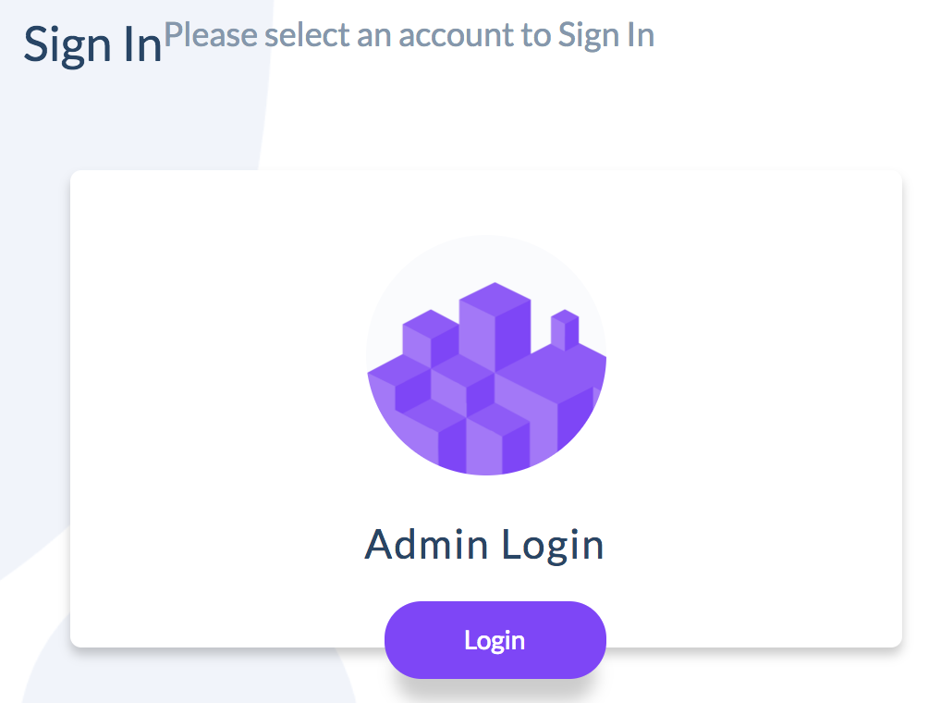
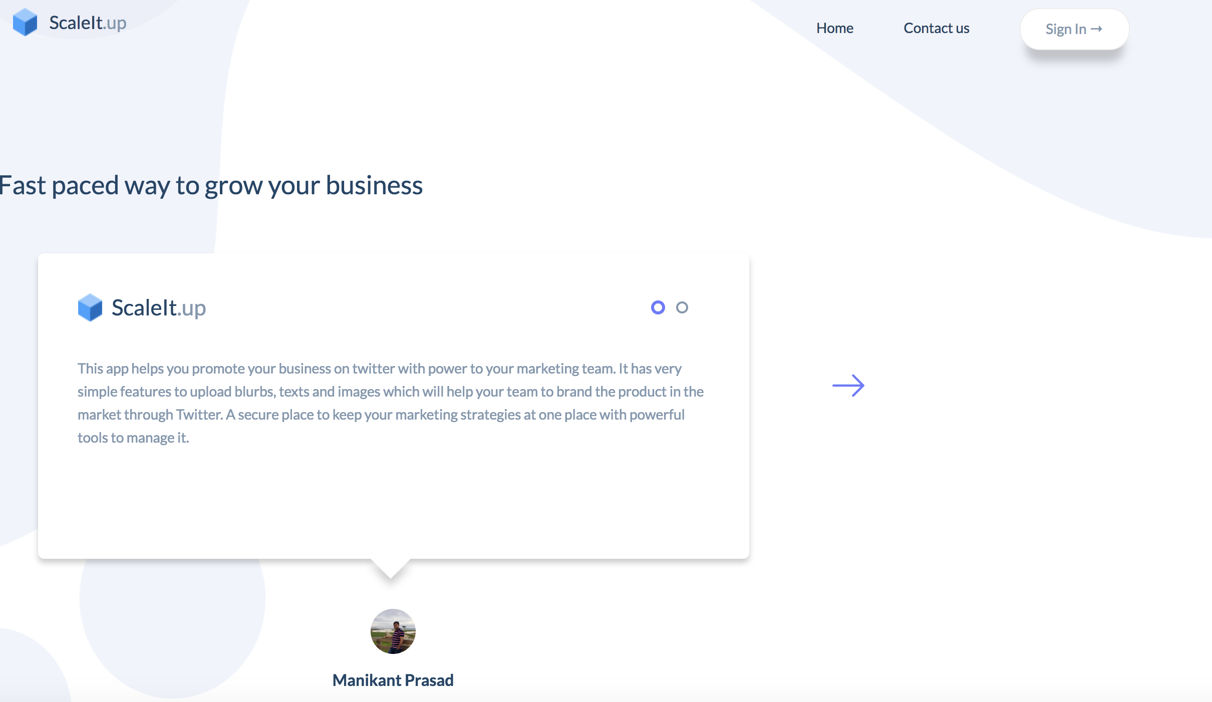
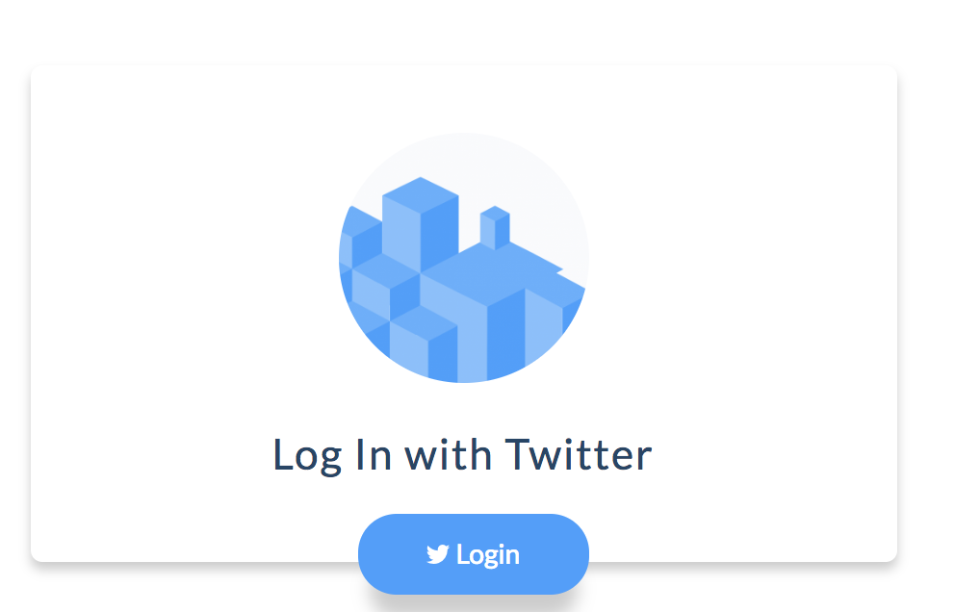
LOGIN & HOMEPAGE

Slide 9
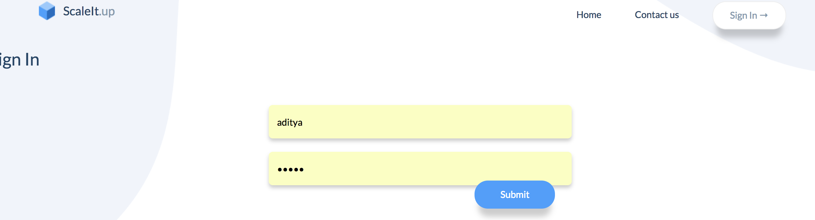
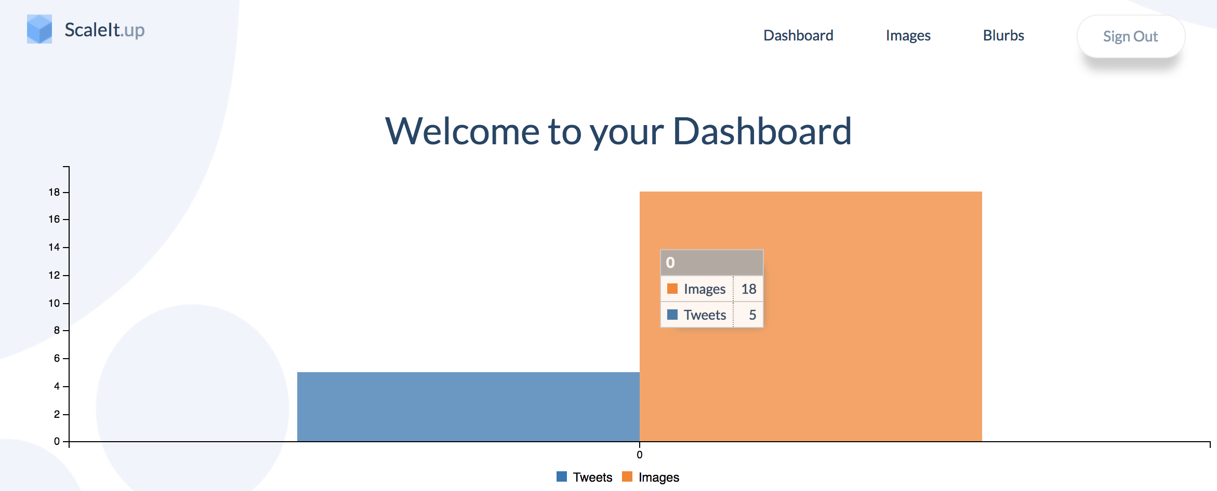
MARKETING TEAM - DASHBOARD

Slide 10
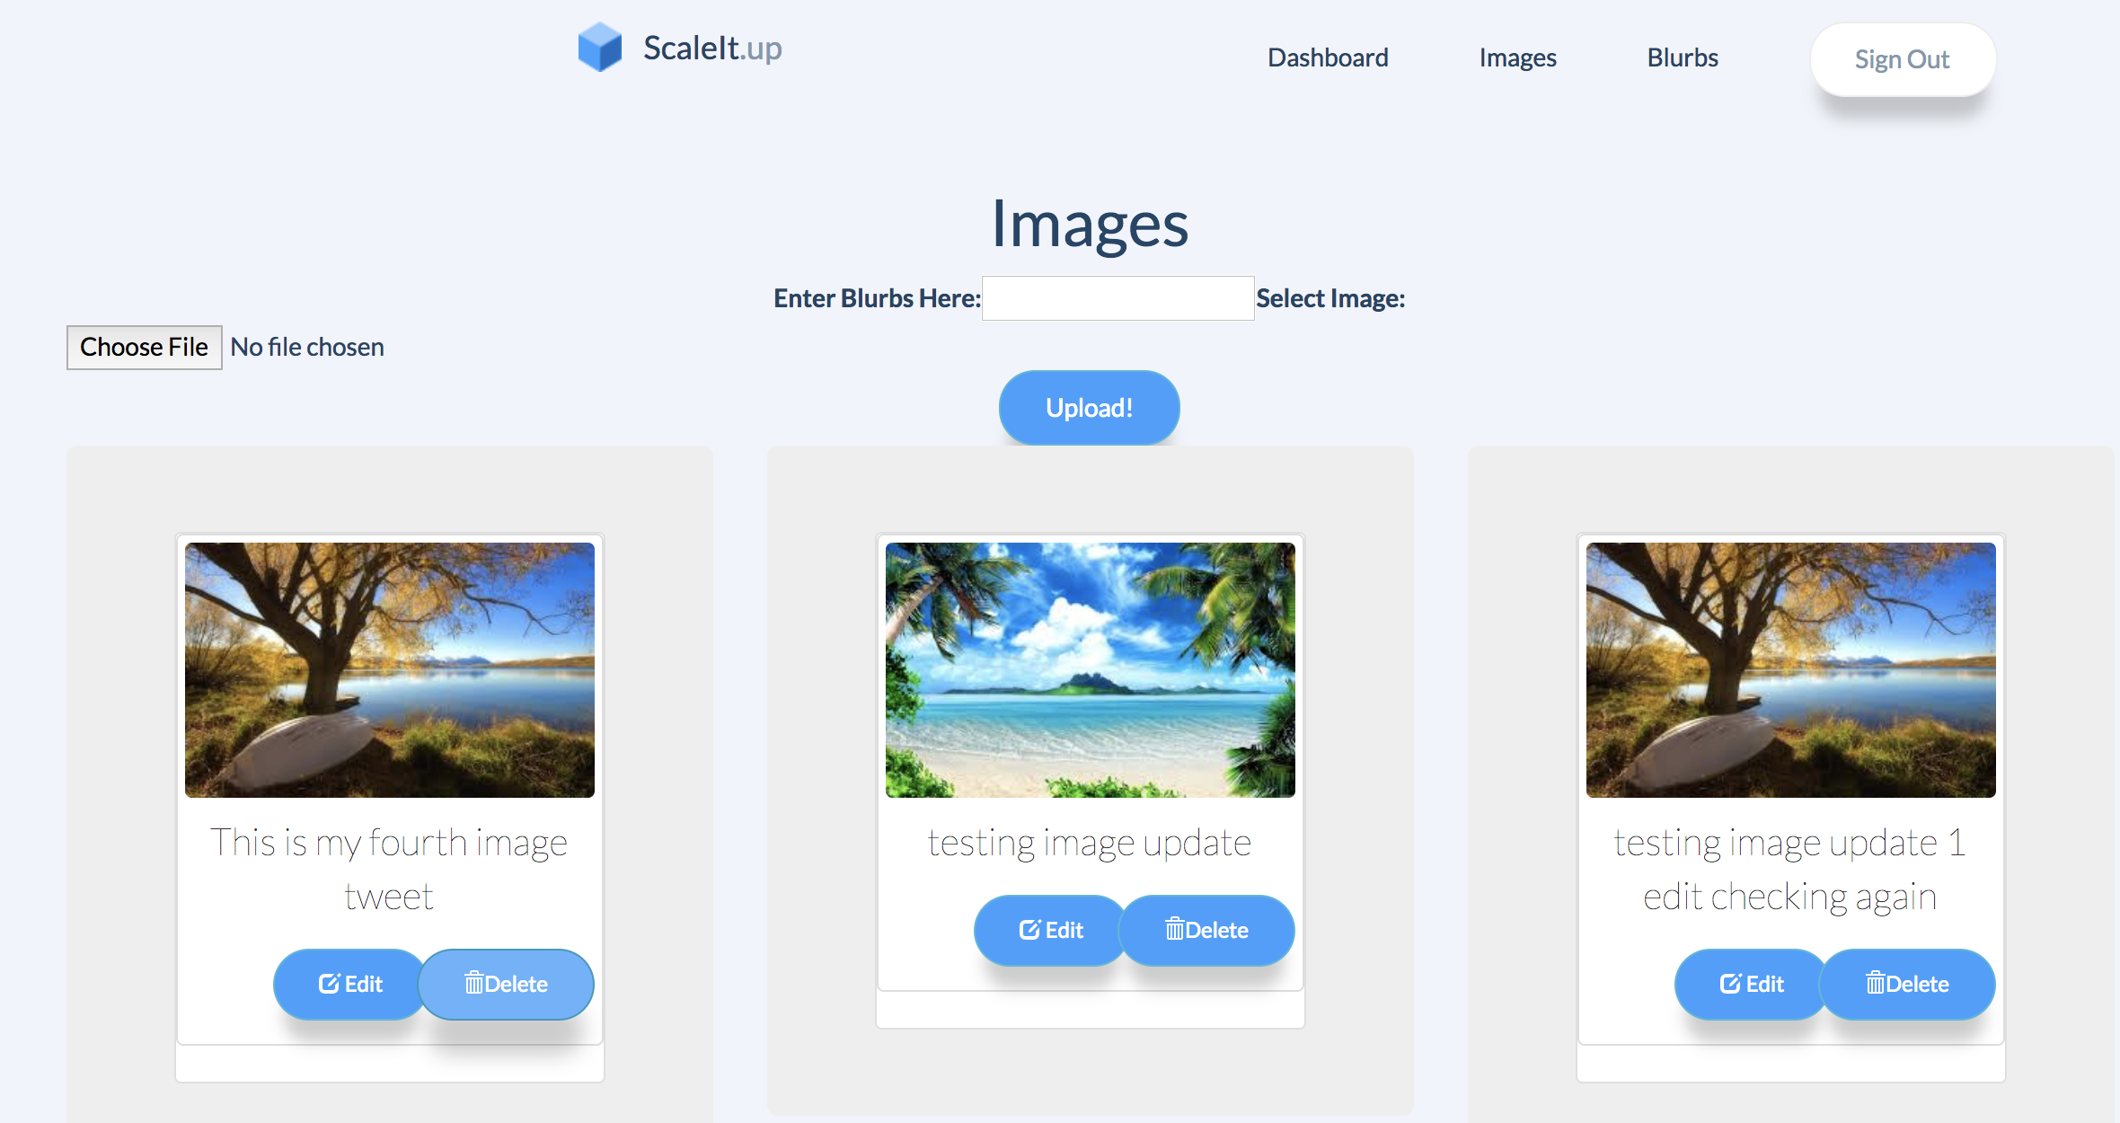
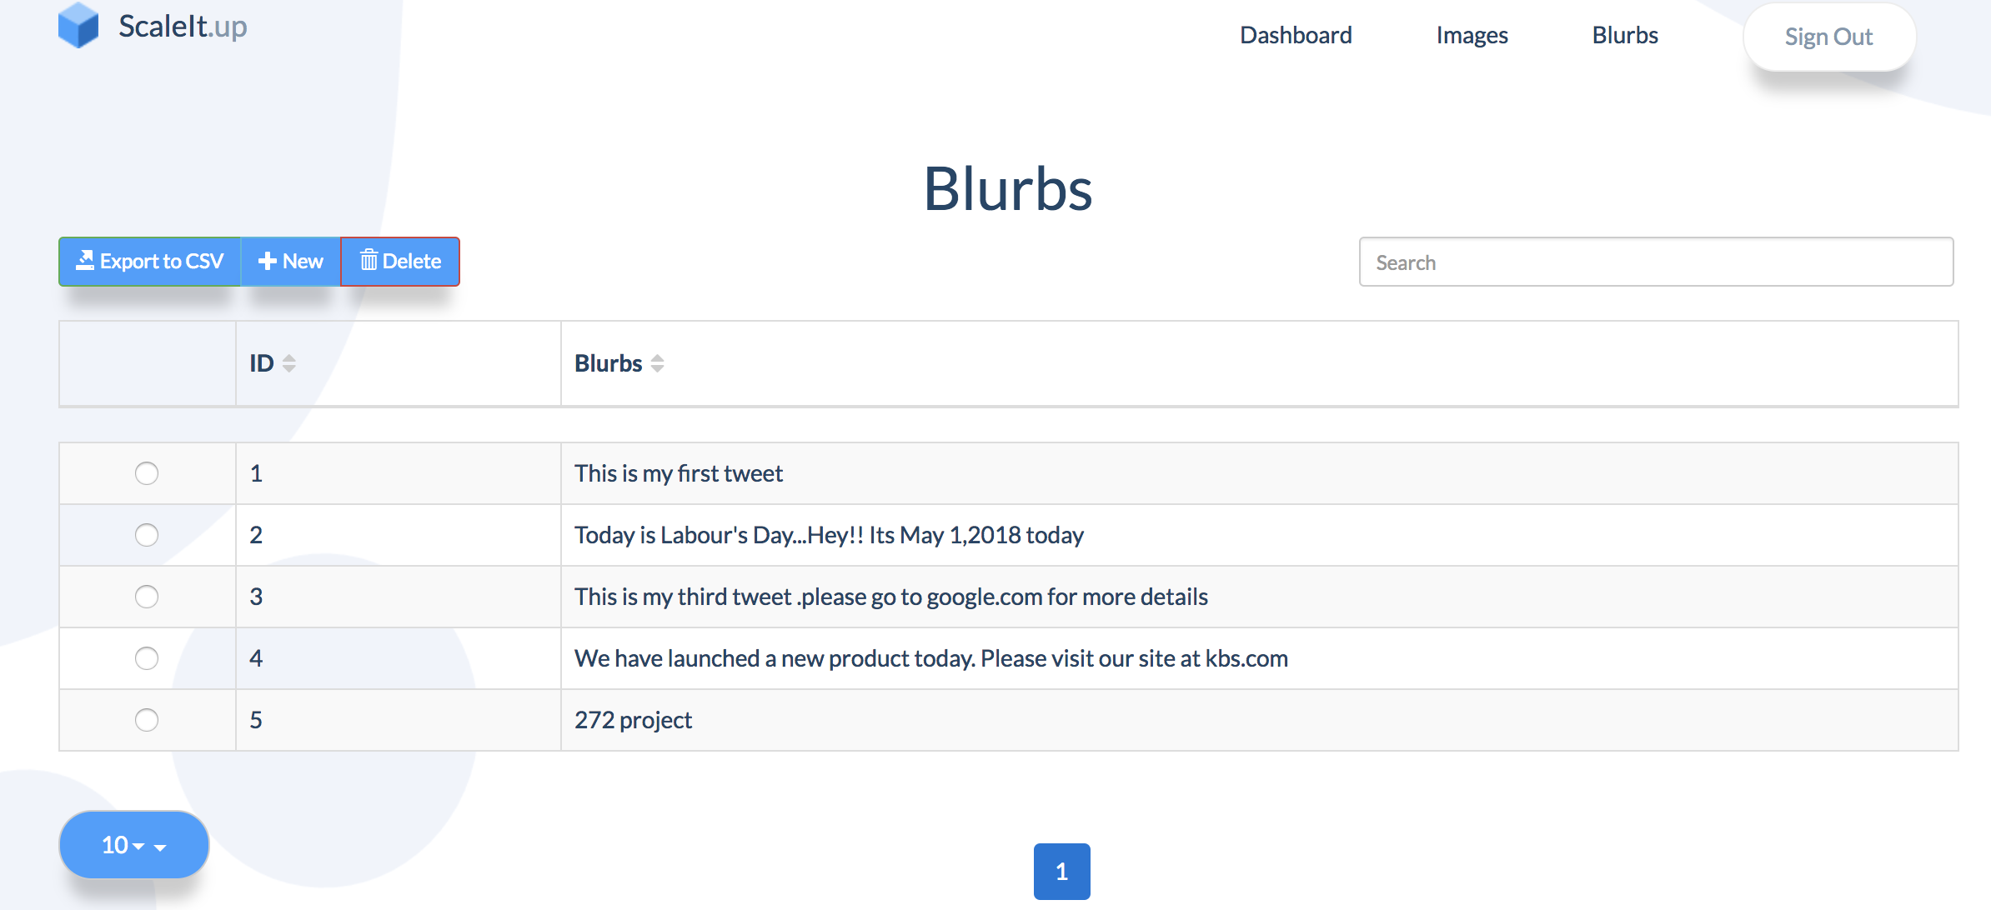
MARKETING TEAM - BLURBS & IMAGES
Marketing Team Can Add, update and delete Blurbs and Images.
Click on the Blurb text to edit a Blurb, Buttons are provided for Adding and Deleting Blurbs

Slide 11
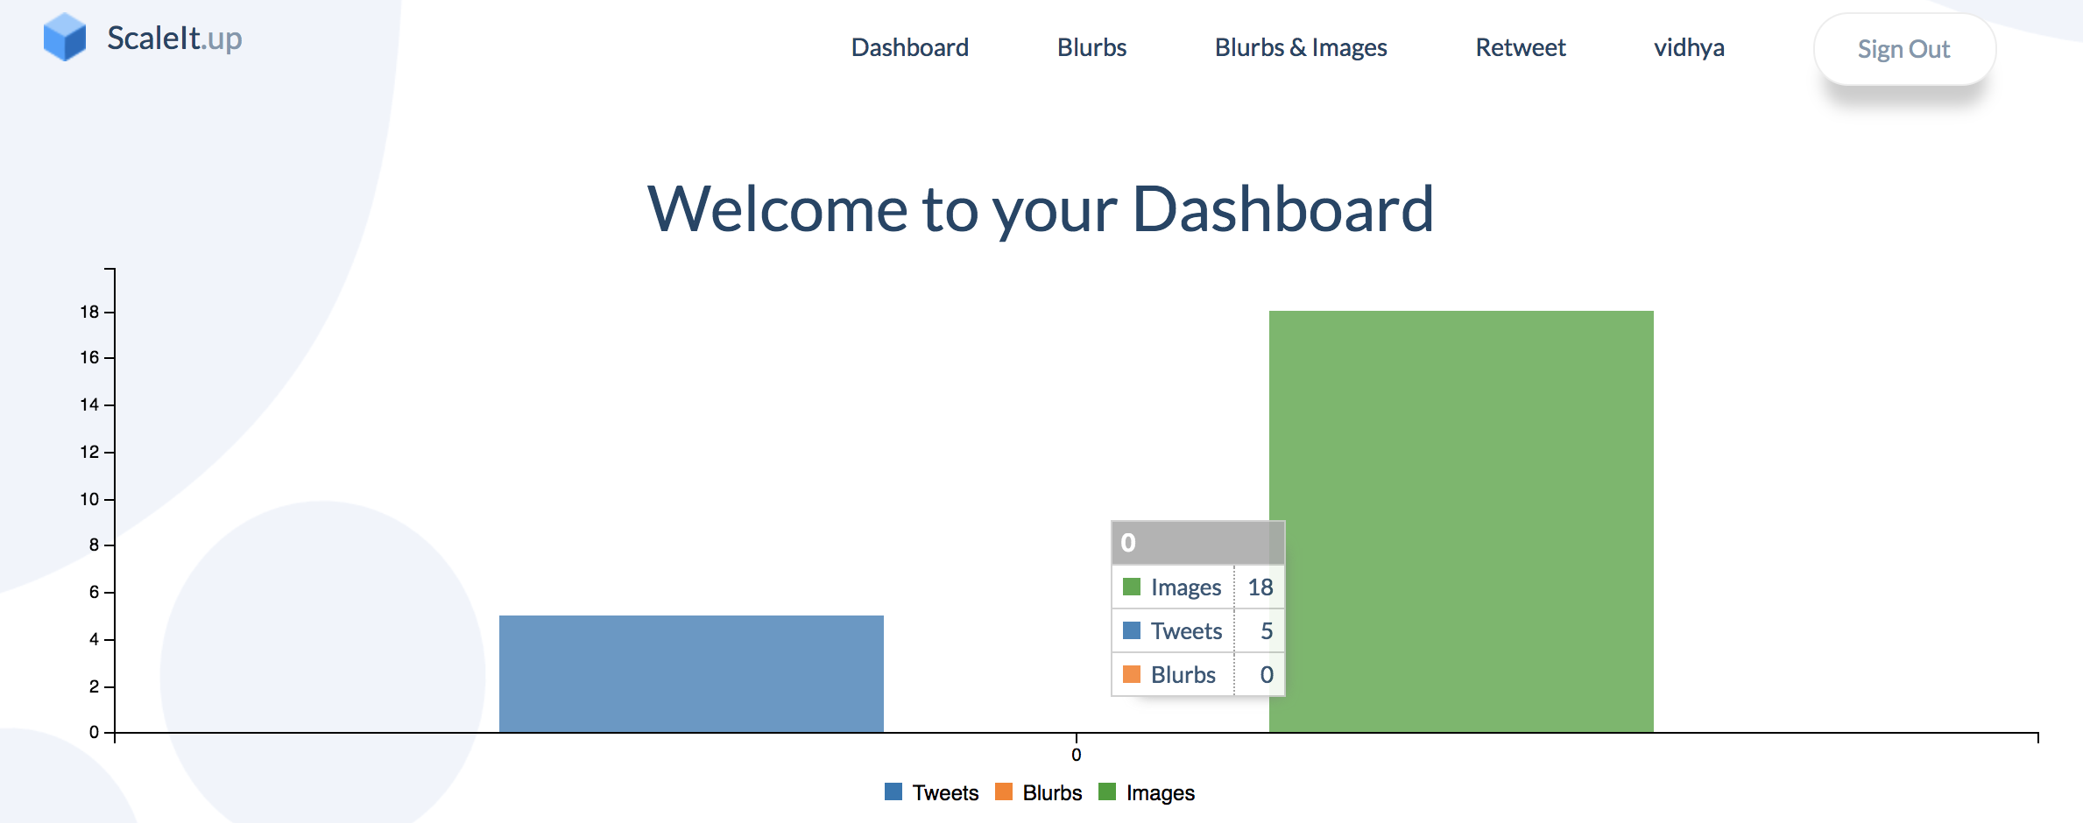
EMPLOYEE LOGIN & DASHBOARD
Employee will login with their twitter account
Clicking on the name will redirect to the users Twitter account

Slide 12
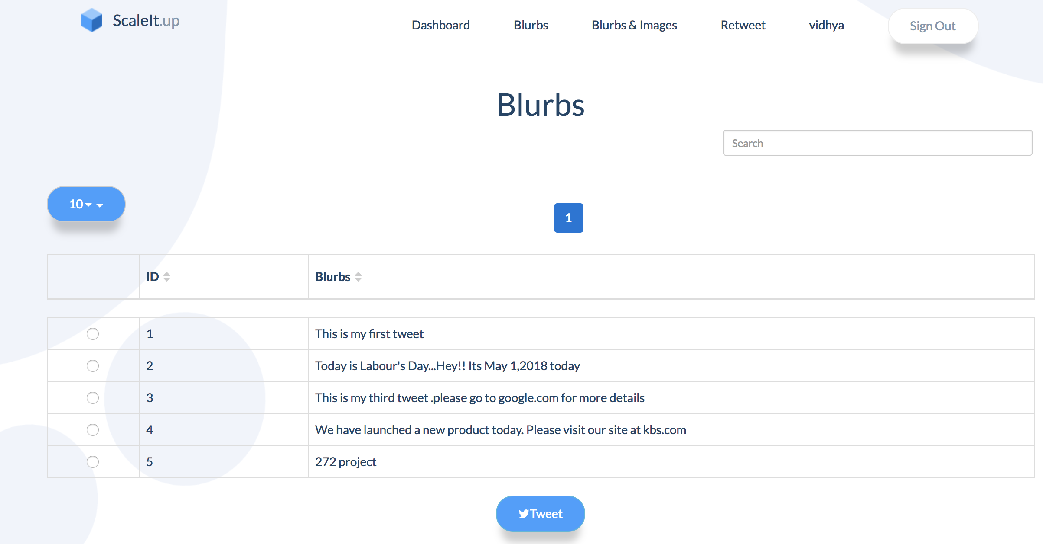
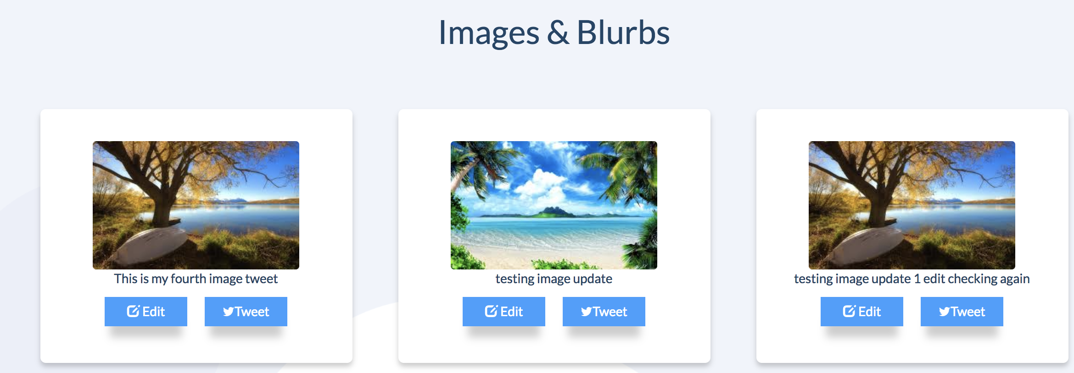
EMPLOYEE _ BLURBS & IMAGES
Employees can directly tweet the needed Blurbs and Images

Slide 13
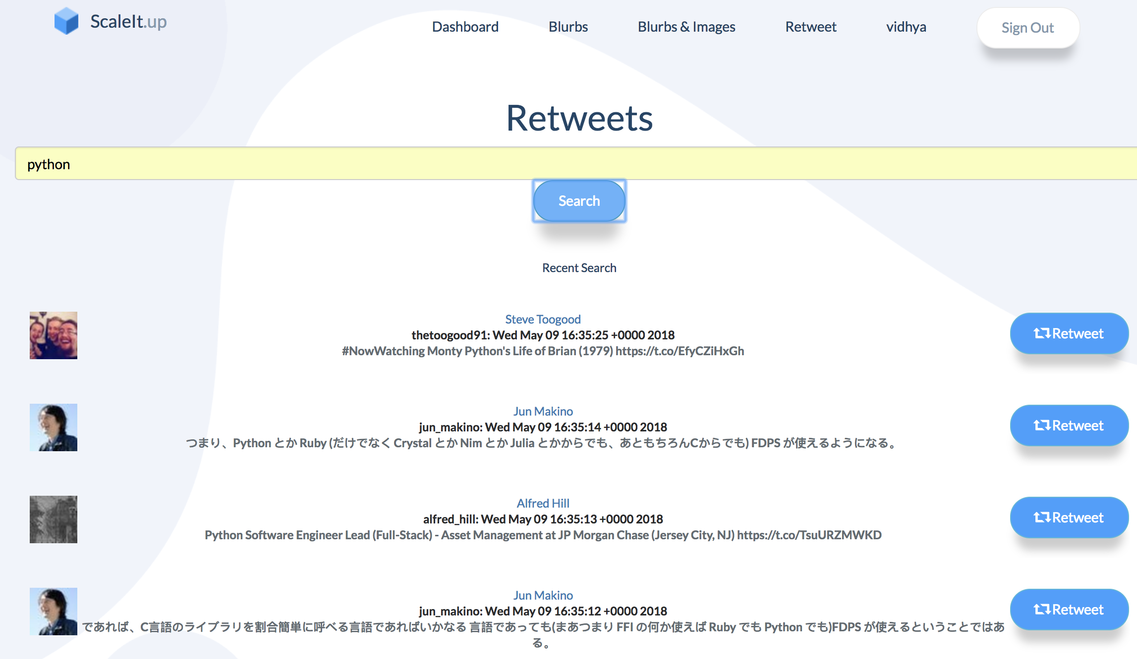
ADDITIONAL FEATURES
We have added an additional feature ‘Retweet’, which includes the following functionality,
Search with a keyword
all the top tweets in twitter will be retrieved and displayed for the users to retweet.

Slide 14
NEXT STEPS
Come up with a revenue generating scheme
Initiate conversations with marketing teams across different companies and propose partnerships
Launch the webapp for public use
Publish the website as a SAAS application

